Slide 1
Smart Home Presentation
Amit Graduation Project

Slide 2
Students Names
Abdullah Mohamed Wahdan
Abdelrahman Youssef Mahrous
Youssef Ashraf Fathy
Youssef Abobakr
Menna Essam
Under the supervision of : Eng / Fathi Mandour (The Course Instructor)

Slide 3
Project Introduction and Headlines
it is a popular project nowadays, it is a very comfortable application for humans, it aims to convert any thing around to be controllable and smart.
We implemented this project using AVR microcontroller (ATmega32) and Atmel studio as the software tool
This Smart home is remotely controlled by a smartphone using Bluetooth module
It have login system for admin and user (admin must be using smartphone)
The admin can register a new user or delete an old one
The username and password are saved in the memory even when power went off using EEPROM

Slide 4
Project Introduction and Headlines
it support the keypad if the smartphone isn’t available (as a user only)
We can control 5 on-off LEDs and a dimming LED, DC Fan (on a specific temperature level) and a smart door controlling its opening and closing
If admin or any user or passwords are entered wrong more than 3 trial, the system must break down and fire alarm until reset.
Admin and user can access to all applies except user cannot control the door opening.

Slide 5
Components Used
Atmega32 →we used Amit kit that comes with a bootloader
Dc motor
Servo Motor
Green LEDs
LM35 (temperature sensor)
Bluetooth module HC-05
Keypad & Lm01602A Character LCD

Slide 6
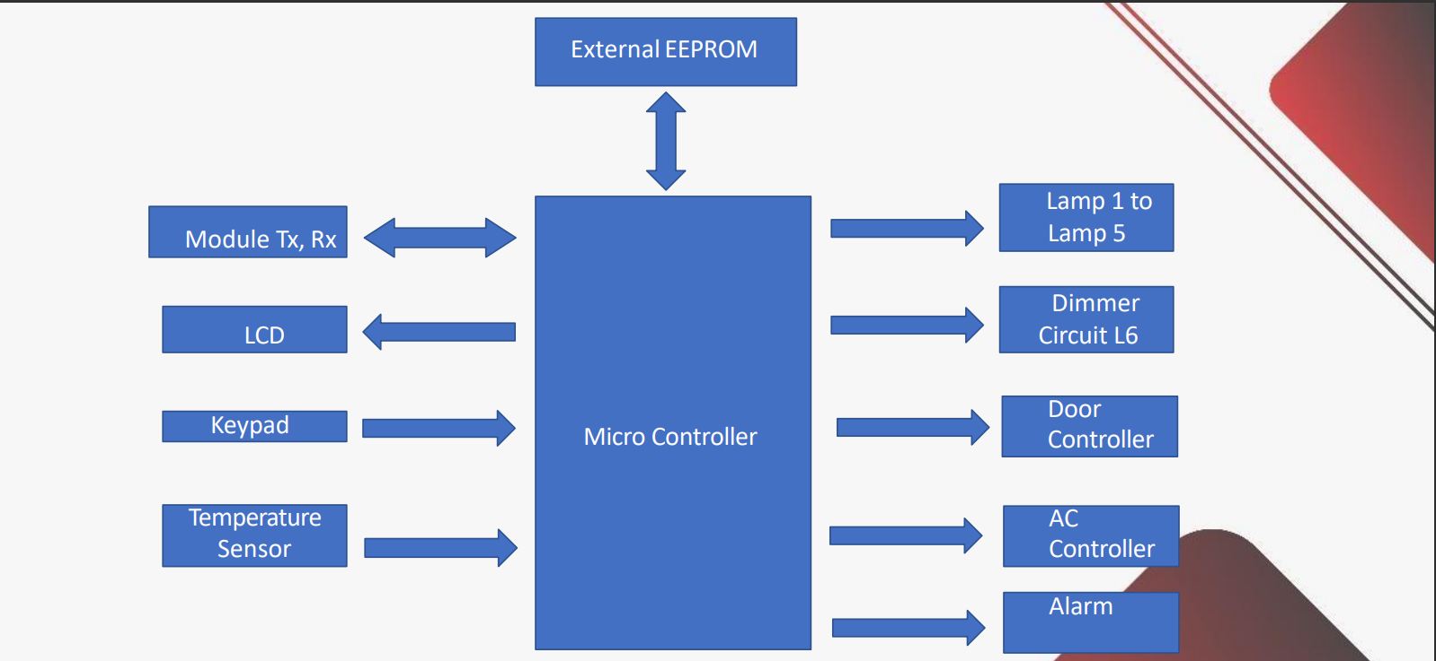
Project Schema and diagram

Slide 7
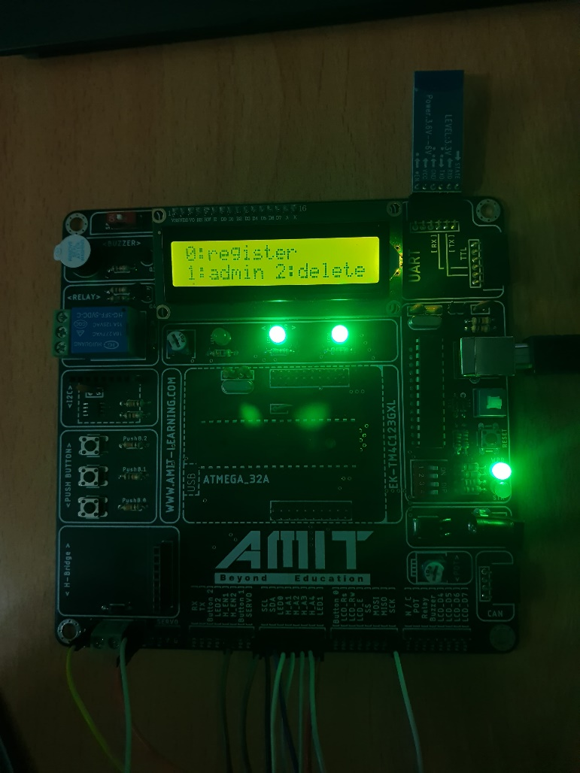
Run-Time explanation
This is the admin part
The admin can register a new user or control anything in the smarthome also he can delete an old user
The admin part is remotely so we have to open the terminal on the smartphone to choose one of this options by sending a char 0,1 or 2

Slide 8
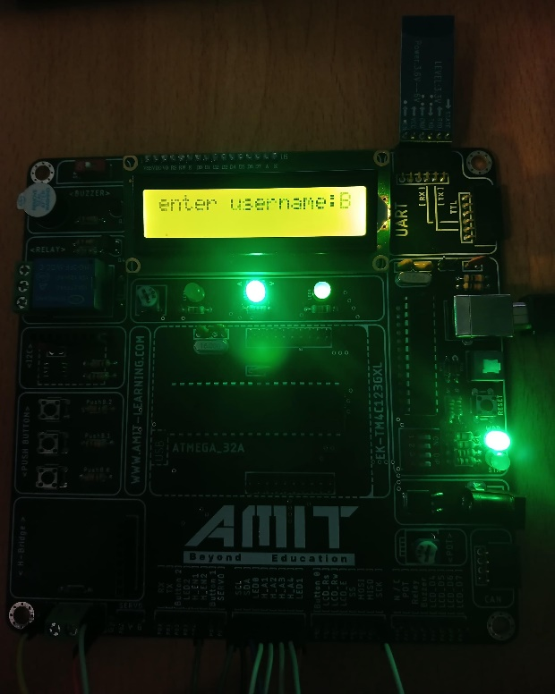
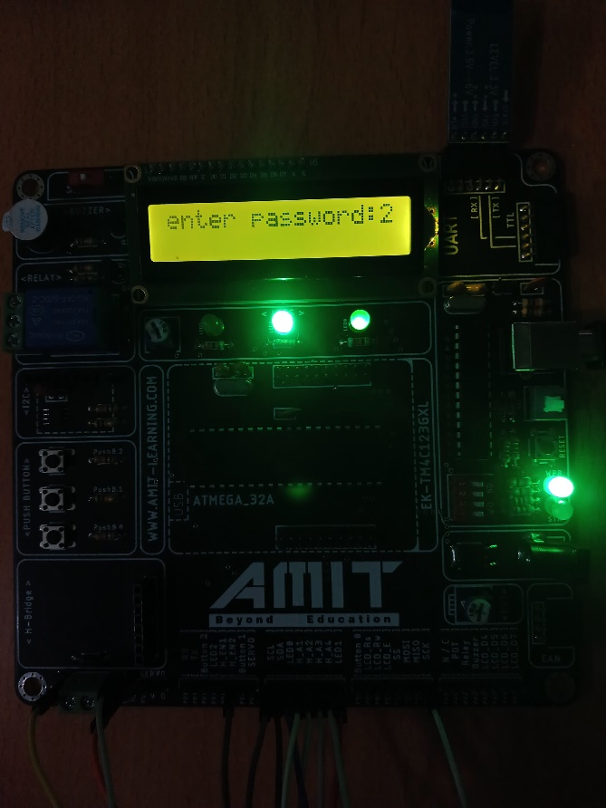
Run-Time explanation
When you try to login as an admin the application asks you to enter the valid username and password for the admin
This username and password were previously stored privately in the code so the application can have only one admin
After entering the username and password the application check its validity

Slide 9
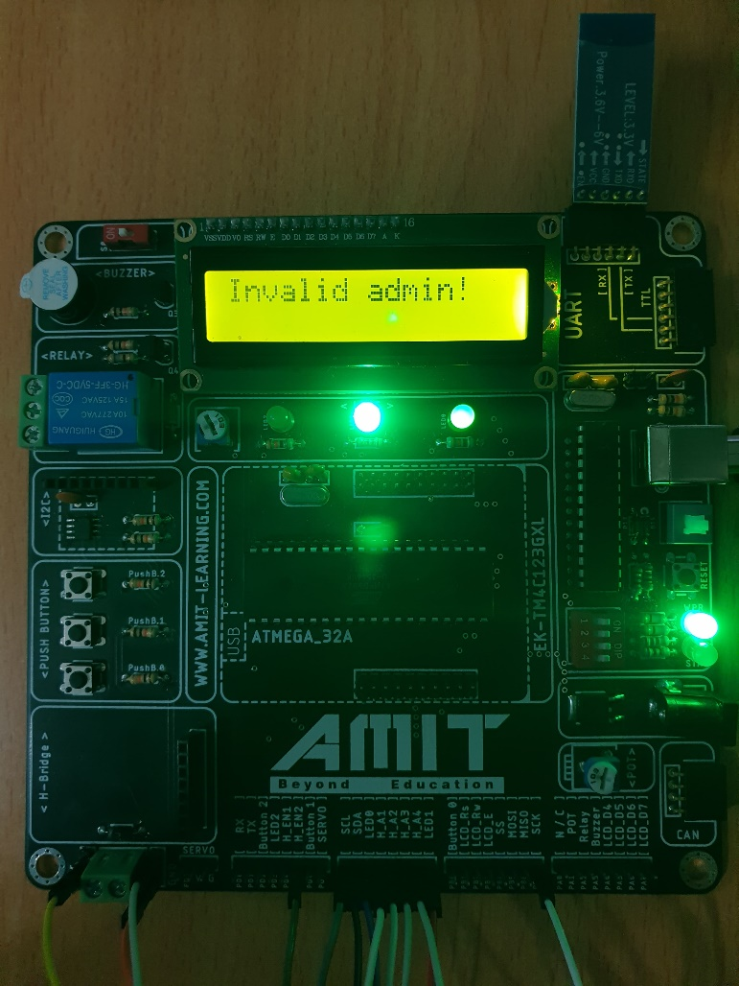
Run-Time explanation
In case you have entered a wrong username or password the application prints out that this info is Invalid

Slide 10
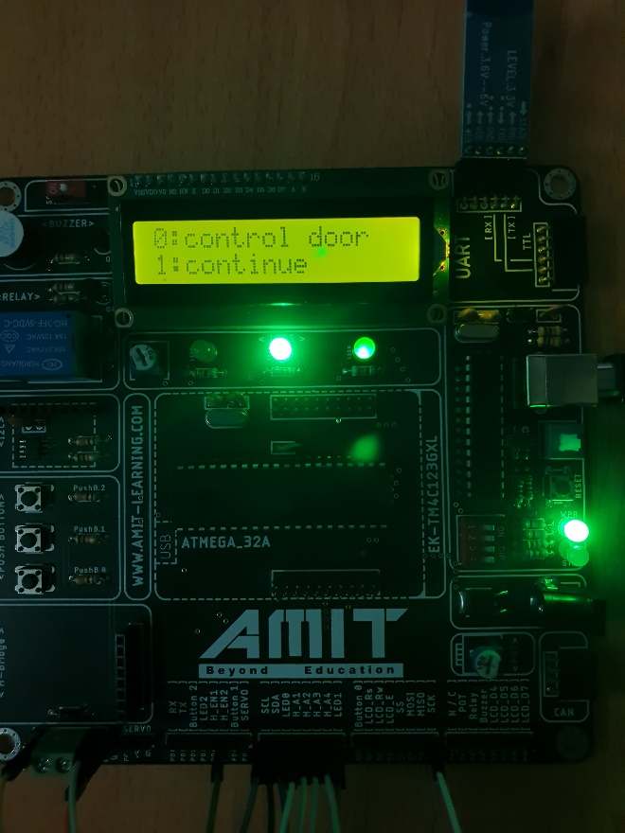
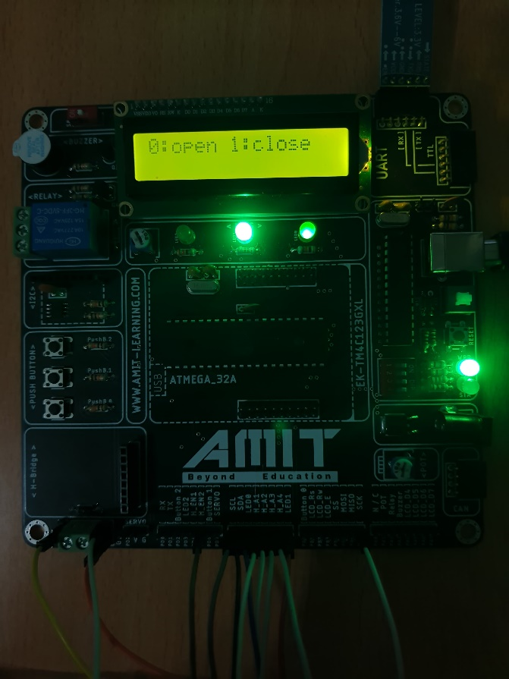
Run-Time explanation
If the password and username are valid , the application gives you the permission to act as the admin who can control the door or check the temperature
There is a Led turns on when the username and password are entered correctly
if you remotely entered 0 you have to choose between opening the door or closing it
Controlling the door is done by using a servo motor

Slide 11
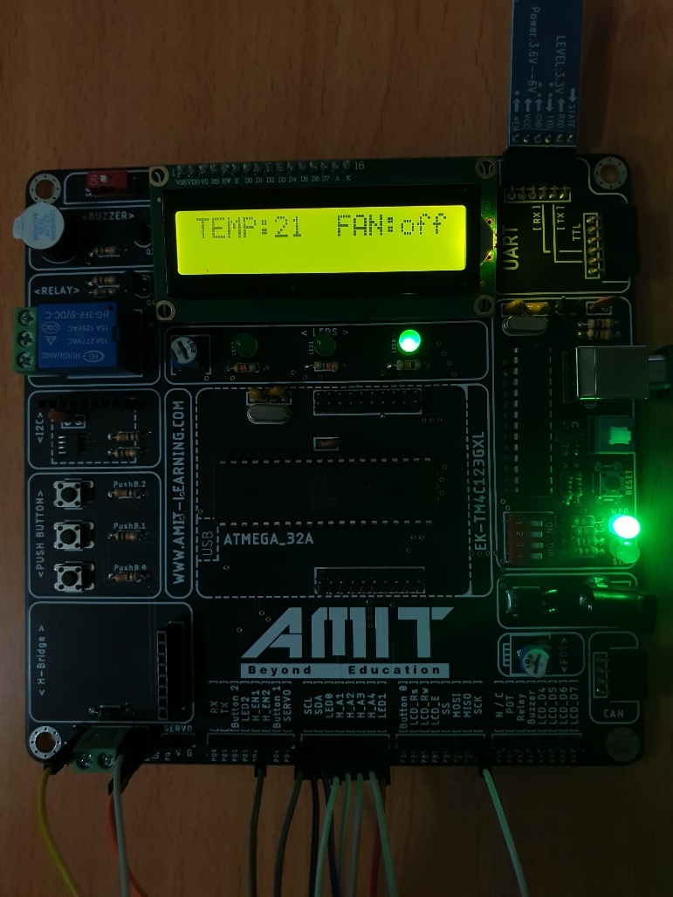
Run-Time explanation
In the previous menu if you choose 1-continue , you will have access to see the temperature read by LM35 and the state of the fan
The fan turns on automatically when the temperature is higher than 28 °C , and it turns off automatically when temperature reaches 21 °C
The fan is used as a DC motor

